Slide 1
Build a metamaterial design studio based on these images. Allow a user to interact and design new structures that explore the design language in its extremes, introducing various levels of hierarchy and order, and to conduct real-time experiments in the frontend (deformation, fracture with a notch, assembling larger material repeats, gradients, etc.). The frontend can be threejs for instance, but the simulation must capture the real physics of a metamaterial including different material classes (linear, nonlinear, etc.). Include an option to export a STL file for 3D printing (in different thickening versions). Give me the entire suite as a ZIP at the end, I want to run the app locally as well.

Slide 2
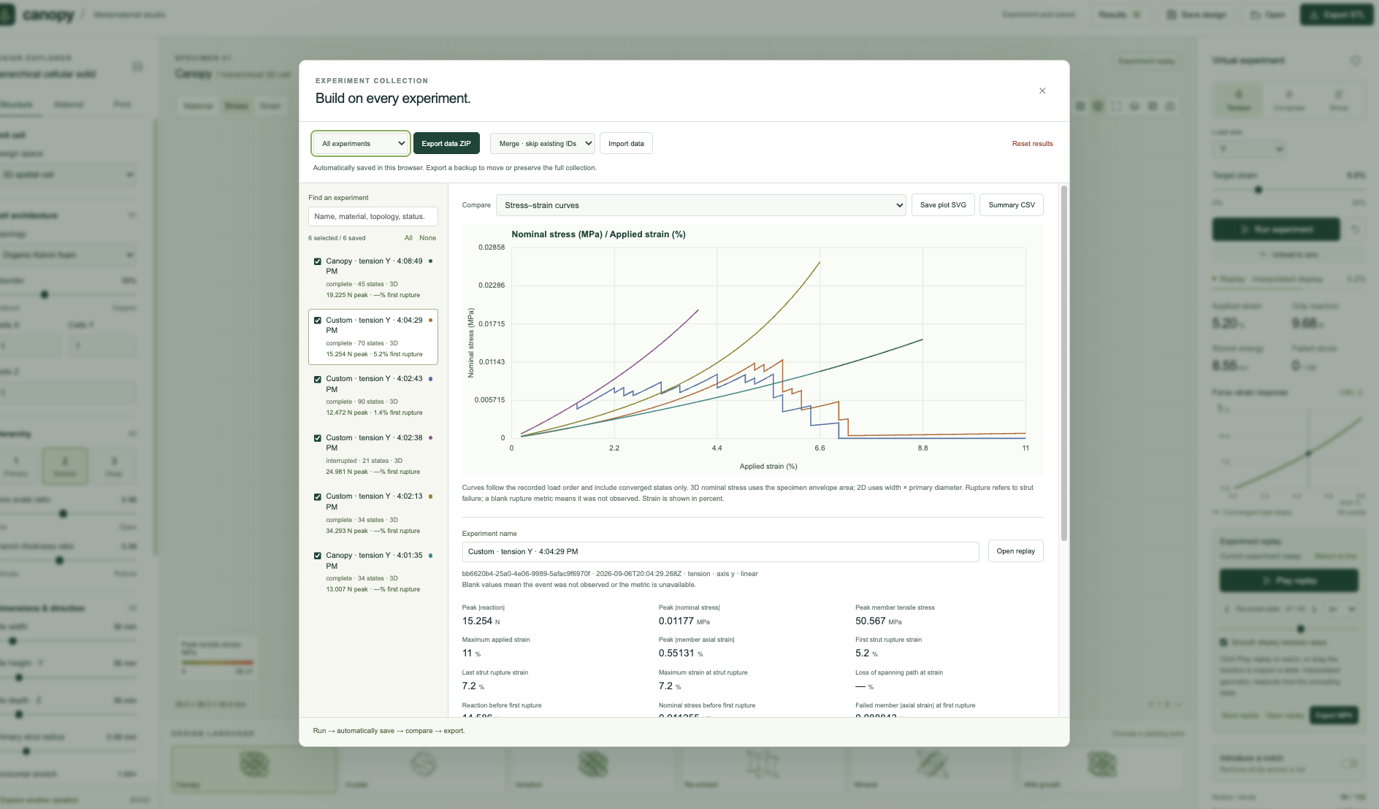

Slide 3


Slide 4
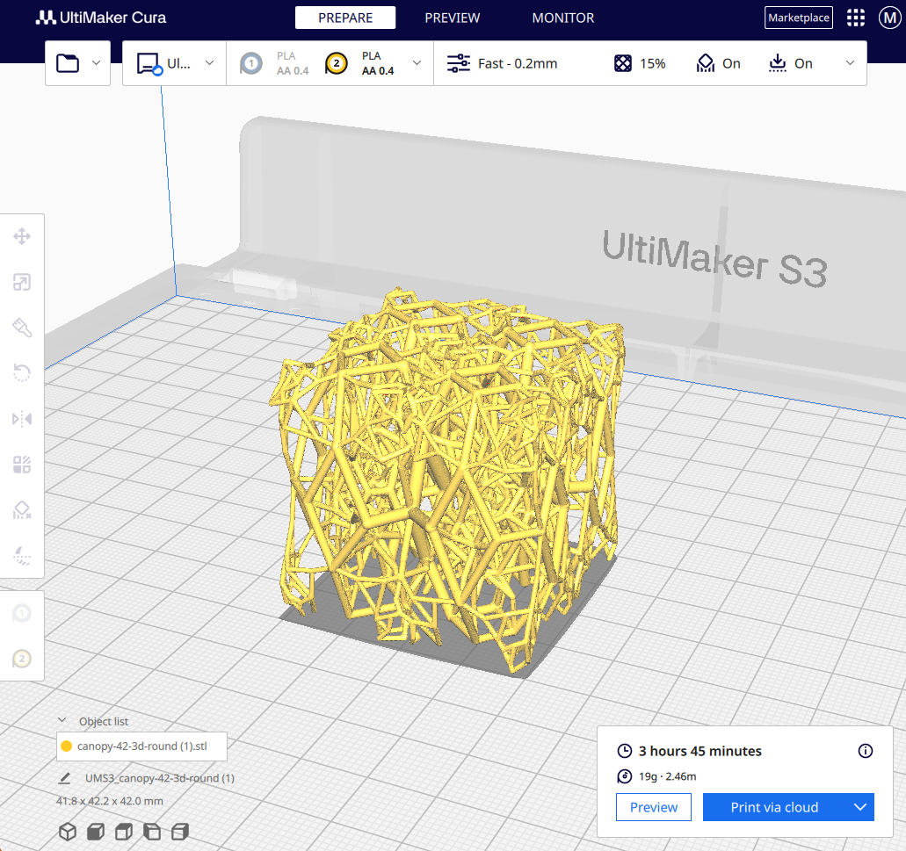
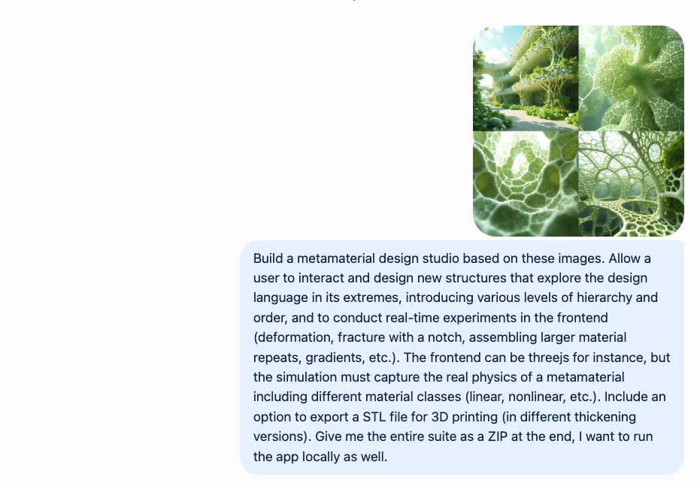
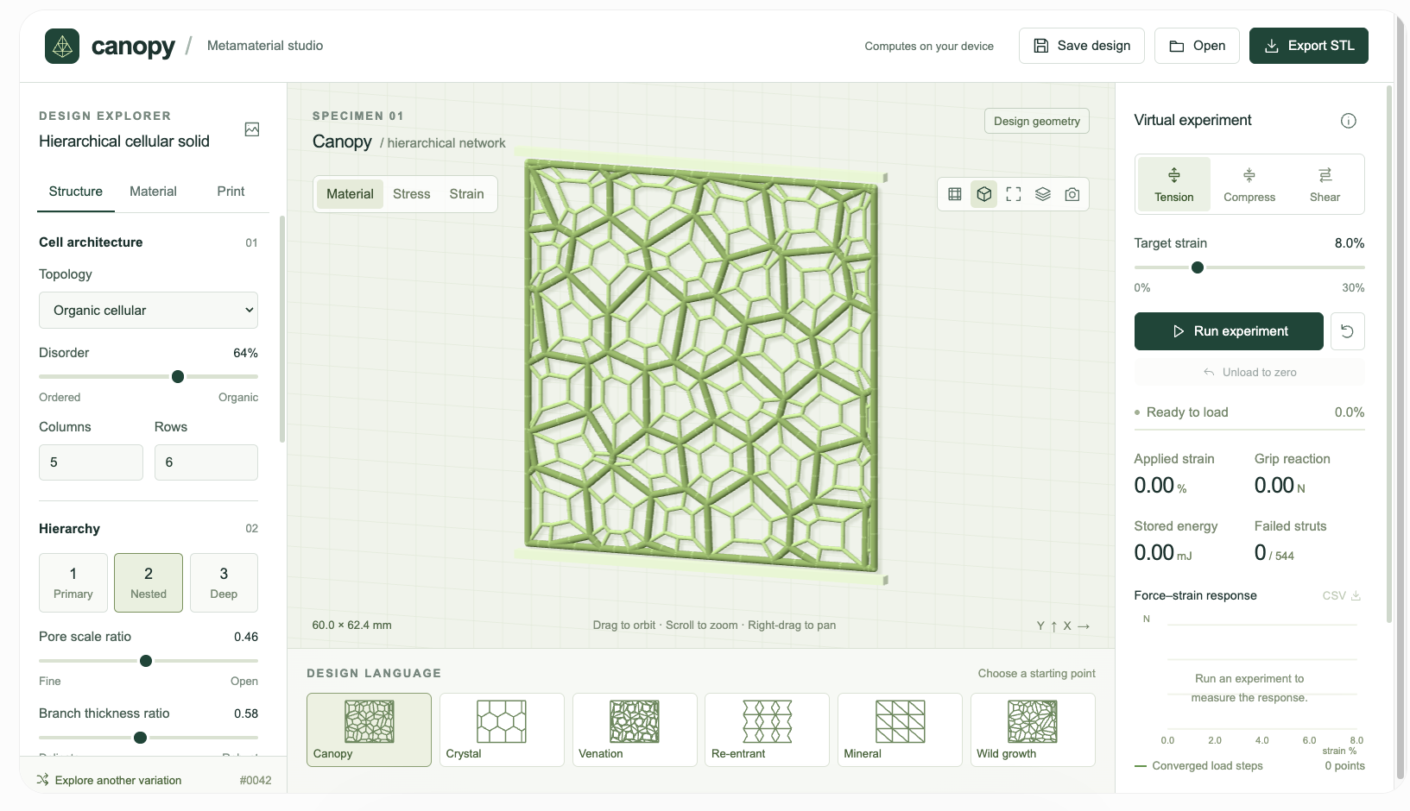

Slide 5
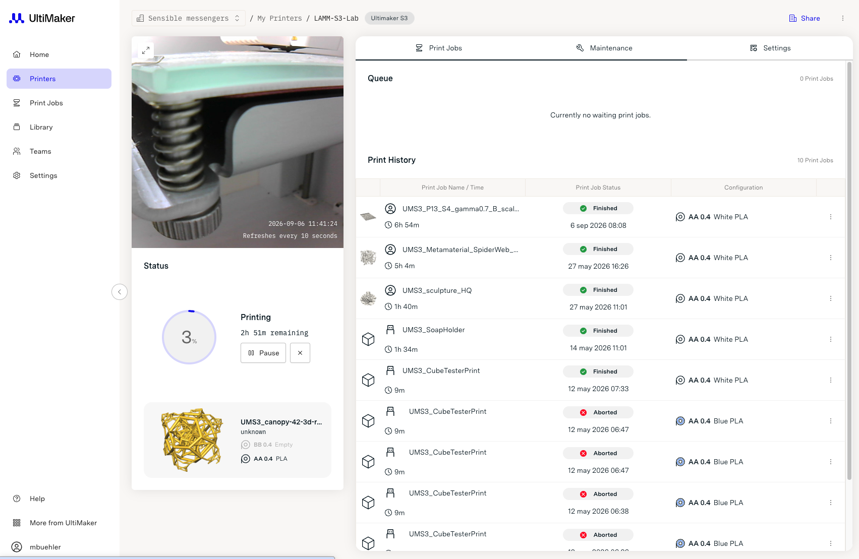
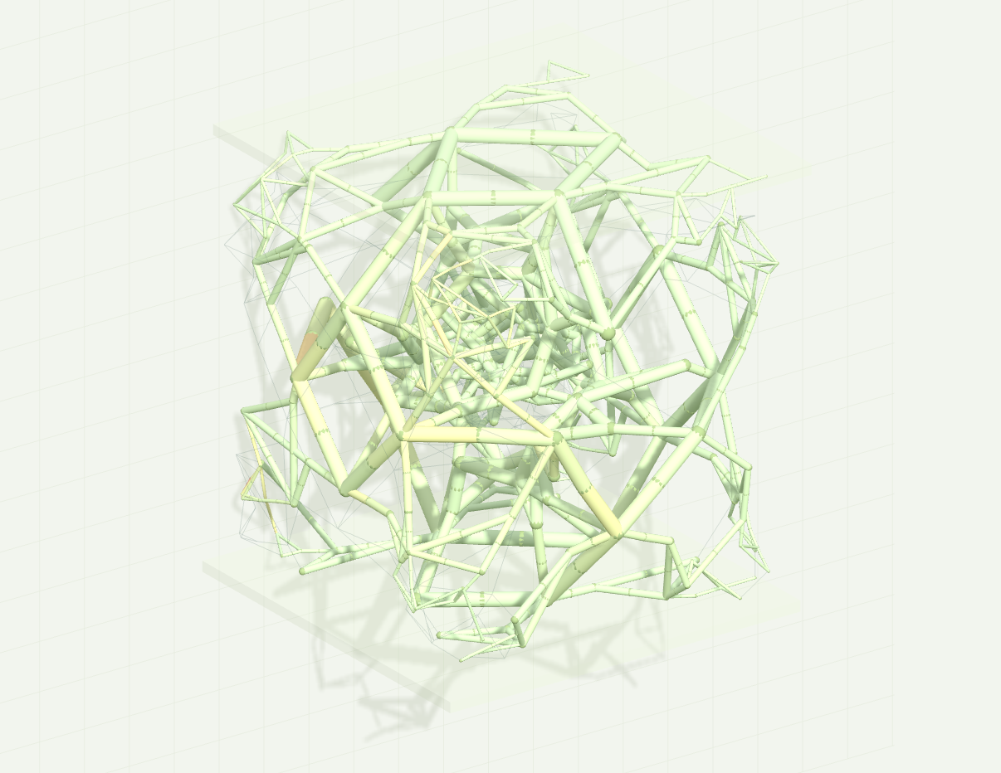

Slide 6
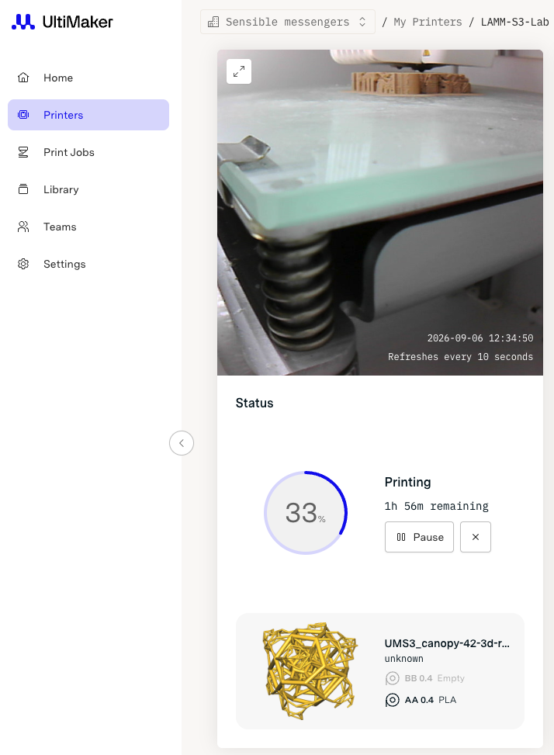

Slide 7
